Slide 1
An Explanation to African Systemic Crisis
Group 8 - SABA

Slide 2
Data Set
13 countries from African continent are included- Algeria, Angola, Central African Republic, Egypt, Ivory Coast, Nigeria, Morocco, South Africa, Tunisia, Zambia and Zimbabwe- from 1860-2014.
Concentrating analysis from 1960 onwards when these countries attained independence.
The data set has 7 categorical variables and 3 numerical variables.
Data set focuses on banking and currency crisis that occurred during 1980s and 1990s and their effects on inflation and exchange rate.
Some information about these countries-
Mostly classified as lower-middle income countries as per World Bank;
These countries were mainly commodity exporter such as- Coffee, Gold, Oil, among others
During 1980, international commodity prices fluctuations affected their external accounts and hence their economy.

Slide 3
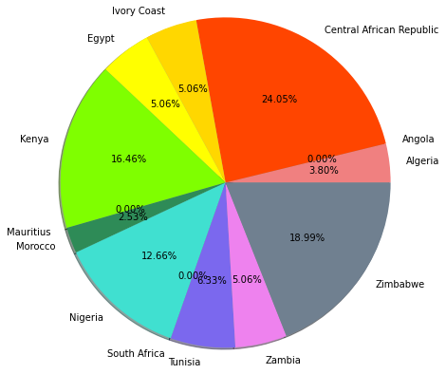
Pie Chart
Total # of Systemic Crisis occurrences (82) represented by percentages for each country from 1960 to 2014
Top 3 countries:
Central African Republic (19)
Zimbabwe (15)
Kenya (13)
Some countries had 0 recorded Systemic Crisis occurrences (Angola, Mauritius, South Africa)

Slide 4
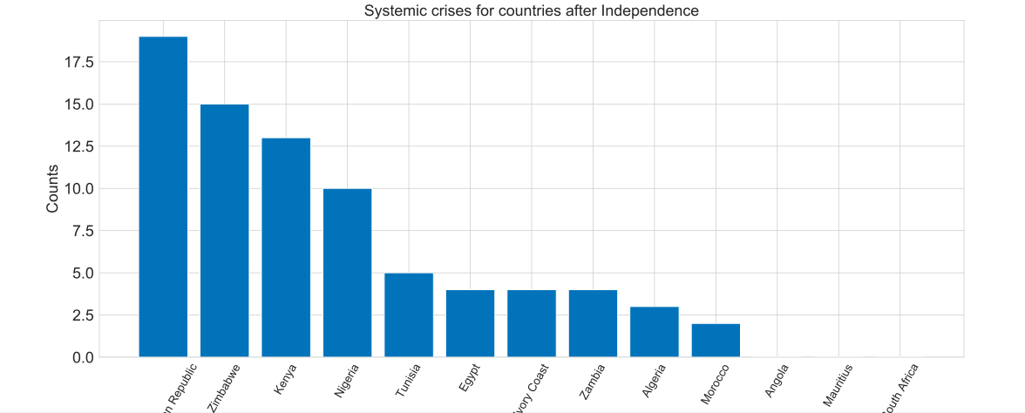
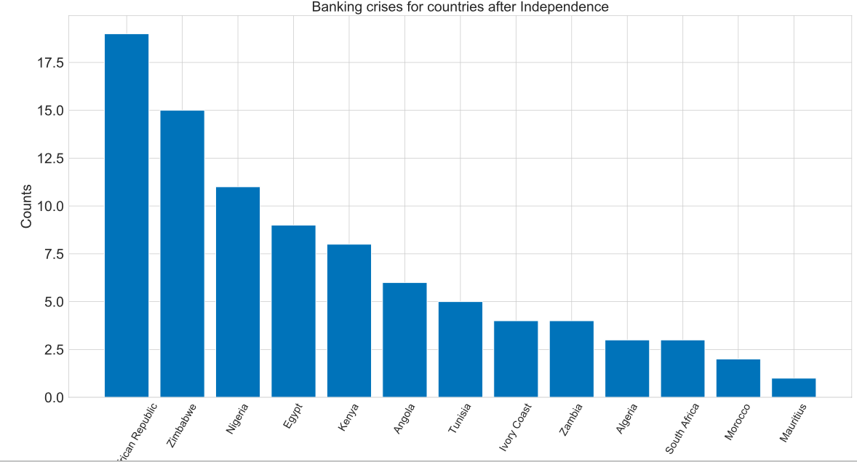
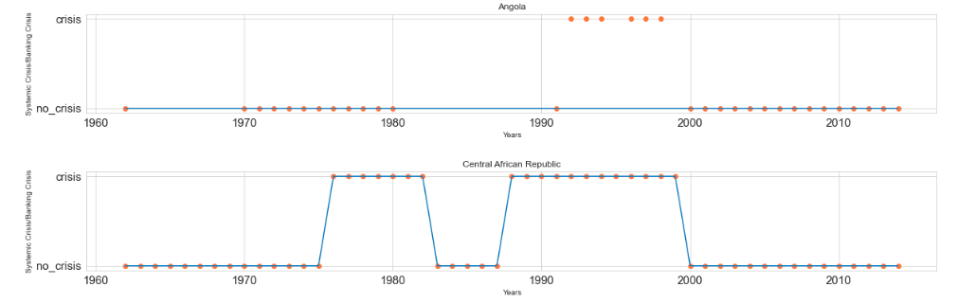
Bar Chart
Systemic and Banking crises for countries after Independence.
Countries having Systemic and Banking crises at the same time

Slide 5
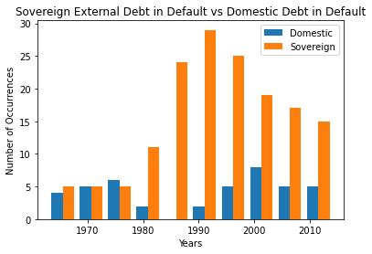
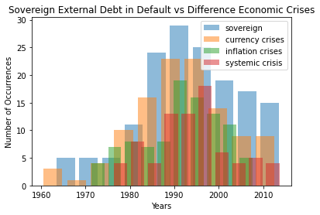
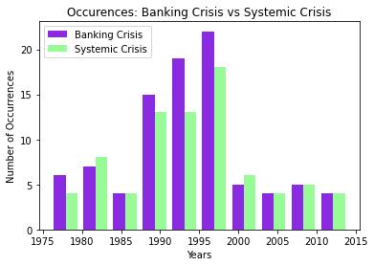
Histogram

Slide 6
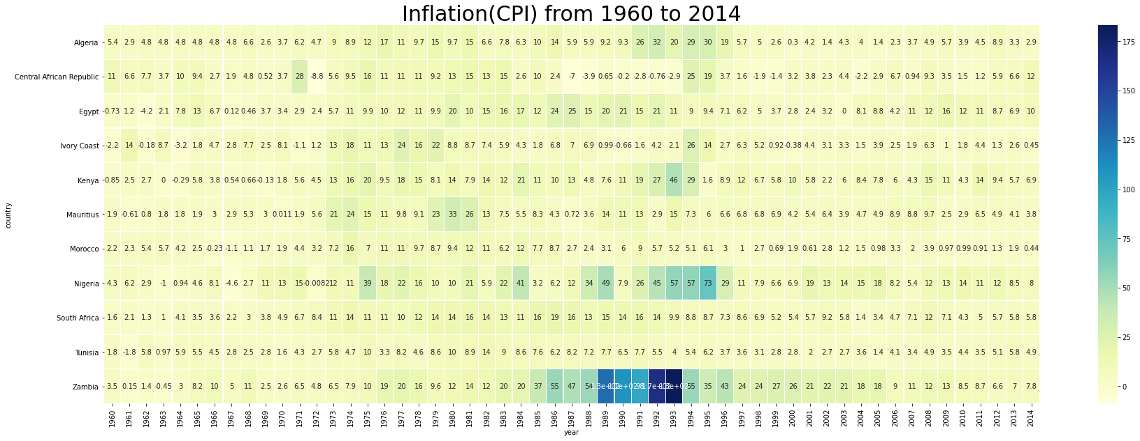
Heat Map

Slide 7
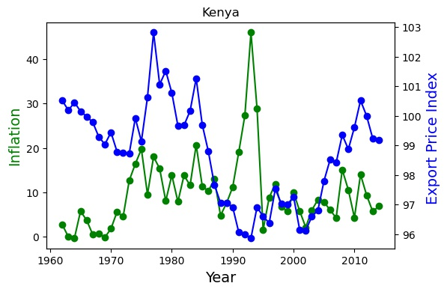
Line Plots
Two countries are taken as example to depict the inverse relationship between rate of growth of export prices and inflation during 1980s -1990s. Most countries experienced similar situation.

Slide 8
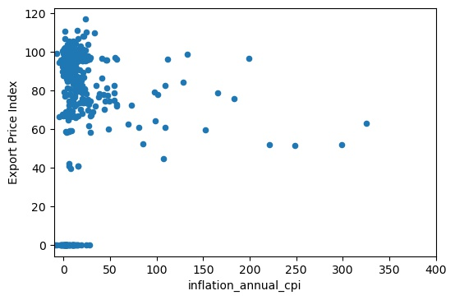
Scatter Plot
 | As the figure depicts, a low but negative correlation between export prices and inflation. Correlation is -0.14 for data between 1980s and 1990s. This negative relation is mainly driven by outliers

Slide 9
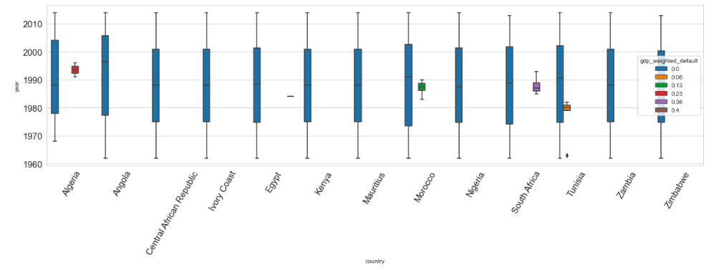
Box Plot

Slide 10
Conclusion
Decline in global commodity prices in 1980s impacted the trade/external accounts of these countries
With limited export diversification and low capital inflows, spillover effect of price increase becomes stronger on economy
For economies which was heavily dependent on oil and gas revenues and had borrowed billions of dollars at high rate of interest under the assumption that oil revenues will help in repayments ended up with spending all oil income to their external debt leading to worsened economy and crisis

Slide 11
Recommendation
More variables should be included such as:
government deficit,
external and domestic debt,
trade deficit
export and import prices indices and
rate of growth of GDP and
interest rates
Including data from 1860s is redundant as systemic crisis happened after 1960 is studied hence it could be taken off the data set.
Most of the countries do not have data before 1950s and imputation for 100 years may not be reliable.
Include group of countries which did not experience systemic crisis even with declined commodity prices for a compare and contrast.

